Slide 1



Slide 2


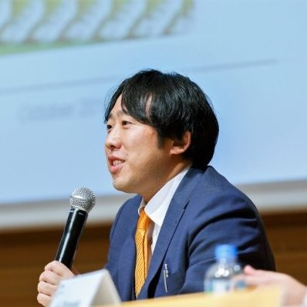

Welcome
Shane
Marcel
Endo San
Host
Chair
GM
OpenChain Automotive Work Group – A Face-to-Face Meeting

Slide 3
Context

Slide 4




Stacking Standards + Solutions
Process Management Standards
Implementation Standards
Methods

Slide 5
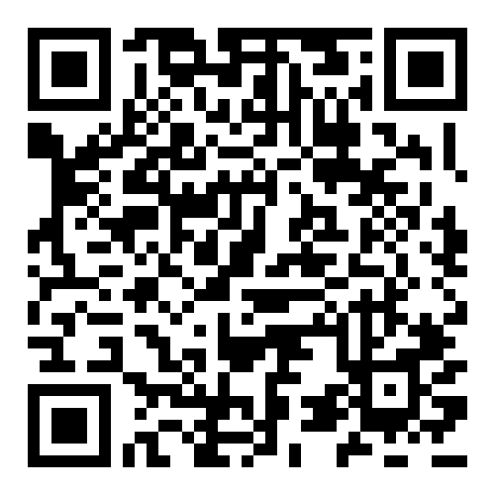
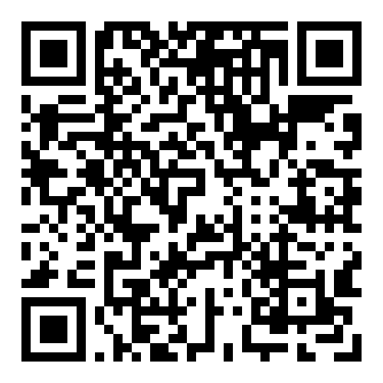
OpenChain Sister Standards
ISO/IEC 5230 (License Compliance)
ISO/IEC 18974 (Security Assurance)
Flexible program size
Covering:
Inbound processes
Internal processes
Outbound processes
Standards about process points
Not about process content

Slide 6
ISO standards are a reputable shorthand in discussions, negotiations and contracts, allowing everything from “expected structure” to “what is a quality program” to be communicated easily. The OpenChain standards are the international baseline for quality in open source license compliance or security assurance programs.

Slide 7
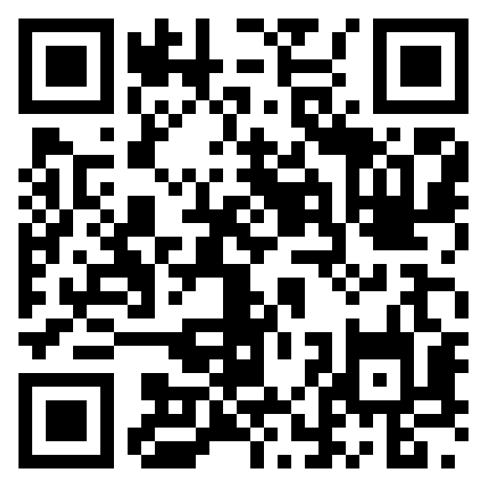
Supported By Community Study / Work Groups
Core Work Groups
Education (Autumn 2020~)
Specification (Spring 2016~)
Community Work Groups
Automation (Summer 2019~)
Community Study Groups
AI (January 2024~)
Industry-Specific Work Groups
Automotive (Summer 2019~)
Telecom (Spring 2021~)
Regional User Groups
China (Sept 2019~)
Germany (Jan 2020~)
India (Sept 2019~)
Japan (Dec 2017~)
Korea (Jan 2019~)
Taiwan (Sept 2019~)
UK (June 2020~)

Slide 8
How This Meeting Works

Slide 9
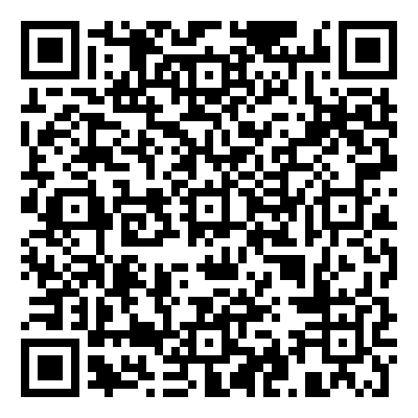
Agenda, Questions and Networking
This meeting has an agenda that you can view online
Everyone in this meeting is welcome to ask questions and share ideas
We focus on practical issues around building trust in the supply chain
We keep it informal and encourage networking to build collaboration
Agenda

Slide 10
Anti-Trust Policy Notice
Linux Foundation meetings involve participation by industry competitors, and it is the intention of the Linux Foundation to conduct all of its activities in accordance with applicable antitrust and competition laws. It is therefore extremely important that attendees adhere to meeting agendas, and be aware of, and not participate in, any activities that are prohibited under applicable US state, federal or foreign antitrust and competition laws.
Examples of types of actions that are prohibited at Linux Foundation meetings and in connection with Linux Foundation activities are described in the Linux Foundation Antitrust Policy available at http://www.linuxfoundation.org/antitrust-policy. If you have questions about these matters, please contact your company counsel, or if you are a member of the Linux Foundation, feel free to contact Andrew Updegrove of the firm of Gesmer Updegrove LLP, which provides legal counsel to the Linux Foundation.

Slide 11
Let’s Get To Know Each Other
Introduction Time!

